Slide 1

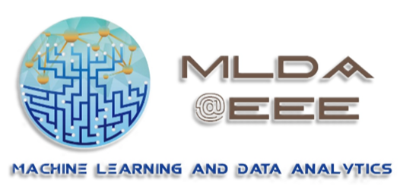
Object Detection & Image Segmentation with

Slide 2
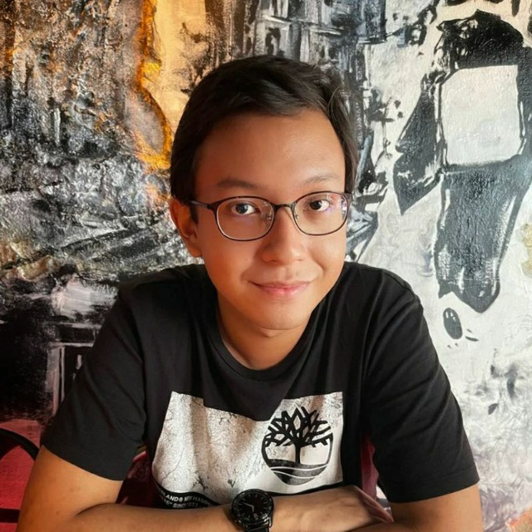
Who am I?
Pye Sone Kyaw
Computer Science Year 3
LinkedIn

Slide 3

Our Mission
Provide an integrated platform for NTU students to learn and implement Machine Learning, Data Science & AI, as well as facilitate connections with the industry.
Training Area with CYNAP Core system for collaboration and presentation
MLDA@EEE
FYP/DIP/URECA
Industry Projects
>17 Workshops
>1000 Trained ML practitioners
>10 Academic Projects
>30 Industry projects
>5 competition
>15 Industry Partners
18 AIO workstations
6 Deep Learning Workstations, 4 Nvidia GTX 1080i cards each
ML Career Kickstart
events
Ample space for project work
Workshops
&
Competition
GPU Servers (4 x V100 + 6 x V100) and storage server
Notes:
MLDA@EEE is a student centric lab which aims to provide a platform to empower our EEE/IEM students learning and deploying of ML and DA skills and knowledge in both academia and industry. We do so through our various events, project and activities. And as the student committee of MLDA, our mission to execute and plan those events and workshops . And how we do it, we do it through help of our state-of-the-art faculty, resource and technical support to facultice your learning journey in ML and DA which is the hot topic of the decade.. we also impact knowledge and skills for ML through our 4 different pillars of events ranging from our ML projects, industry projects and career events and workshops with competition.

Slide 4
Aims and Scope of Workshop
Intro
What is object detection and image segmentation
Library
Getting started with Detectron2
Train
Training of models
Visualizing results and options for deployment
Deploy
Data
COCO dataset format and data annotation
Participants should ideally have:
Python programming knowledge.
Basic knowledge on machine learning.
Basic idea of Neural Networks.
This workshop does not cover:
Heavy theory
Under-the-hood implementation
Notes:
[4 mins]

Slide 5
What is Object Detection and Image Segmentation?

Slide 6
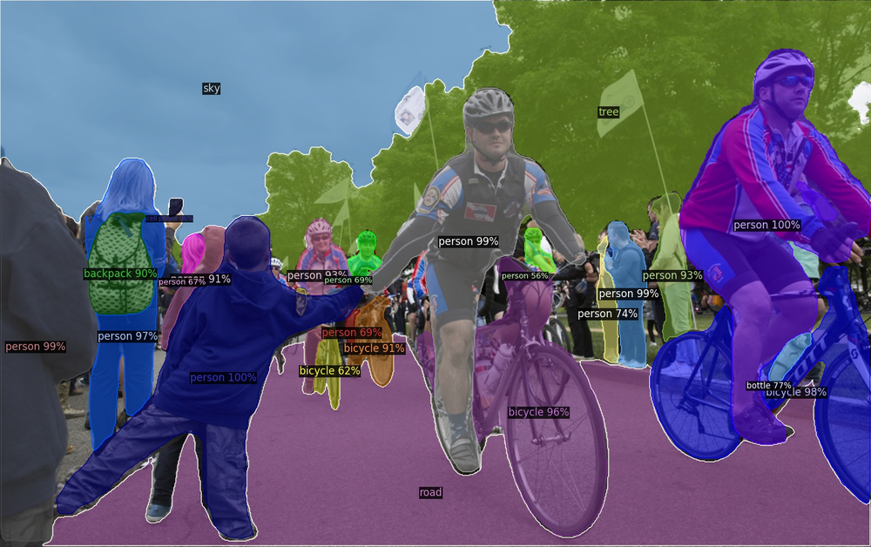
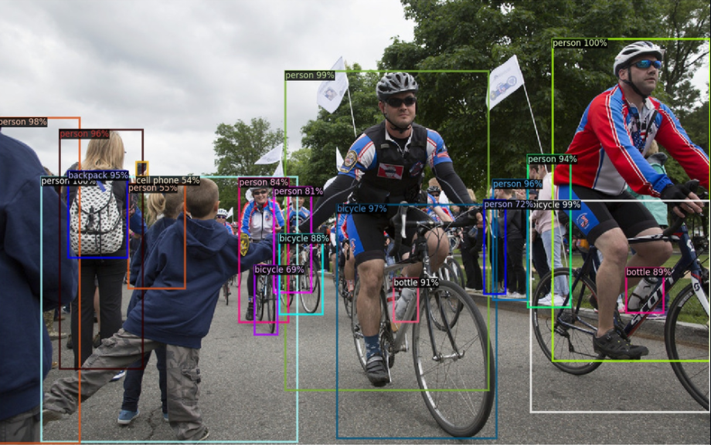
What is object detection and image segmentation?
Segmentation
Detection

Slide 7
Object Detection
Draws bounding boxes around objects of interest
Needs data in the form of bounding box coordinates and labels for each box
Several methods of doing this, but we are not covering theory

Slide 8
Segmentation
Segments out parts of the image according to what it is
Needs data in the form of many polygon coordinates: [(x₁ , y₁), (x₂ , y₂), … , (x_{i} , y_{i})]
Several different types of segmentation

Slide 9
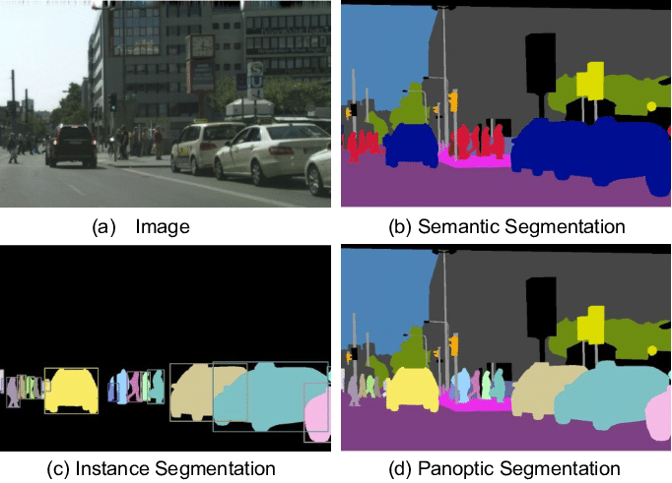
Types of Segmentation
Normal Image
Semantic Segmentation
Instance Segmentation
Panoptic Segmentation
Notes:
Ask participants to point out the differences between the three types of segmentation here
[5 mins]

Slide 10
Dataset Formats & Annotation Tools

Slide 11
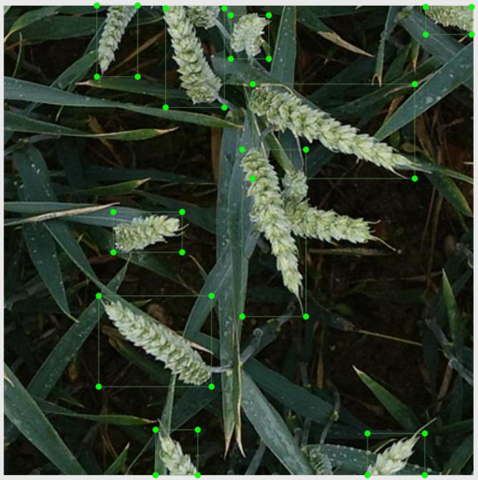
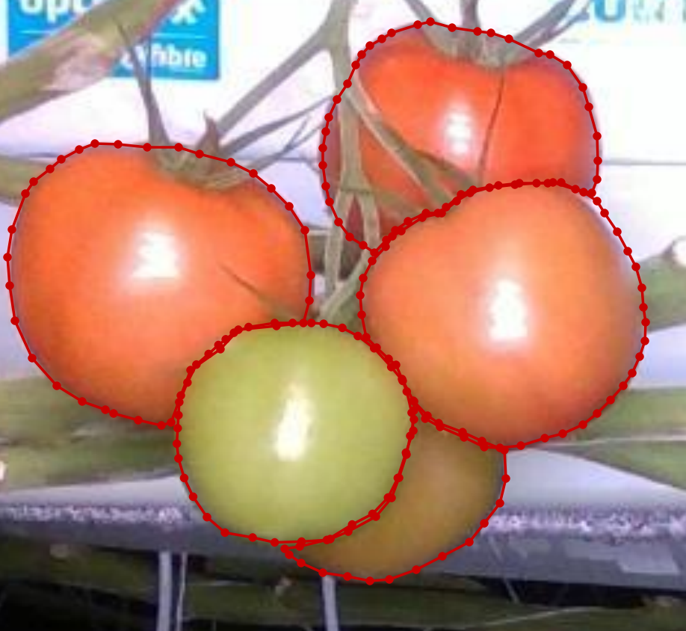
Dataset Formats for Computer Vision Tasks
Beyond classification, tasks like object detection and image segmentation require labels to be more than just a class
Object detection: Bounding box coordinates
Segmentation: Point coordinates for the polygon

Slide 12
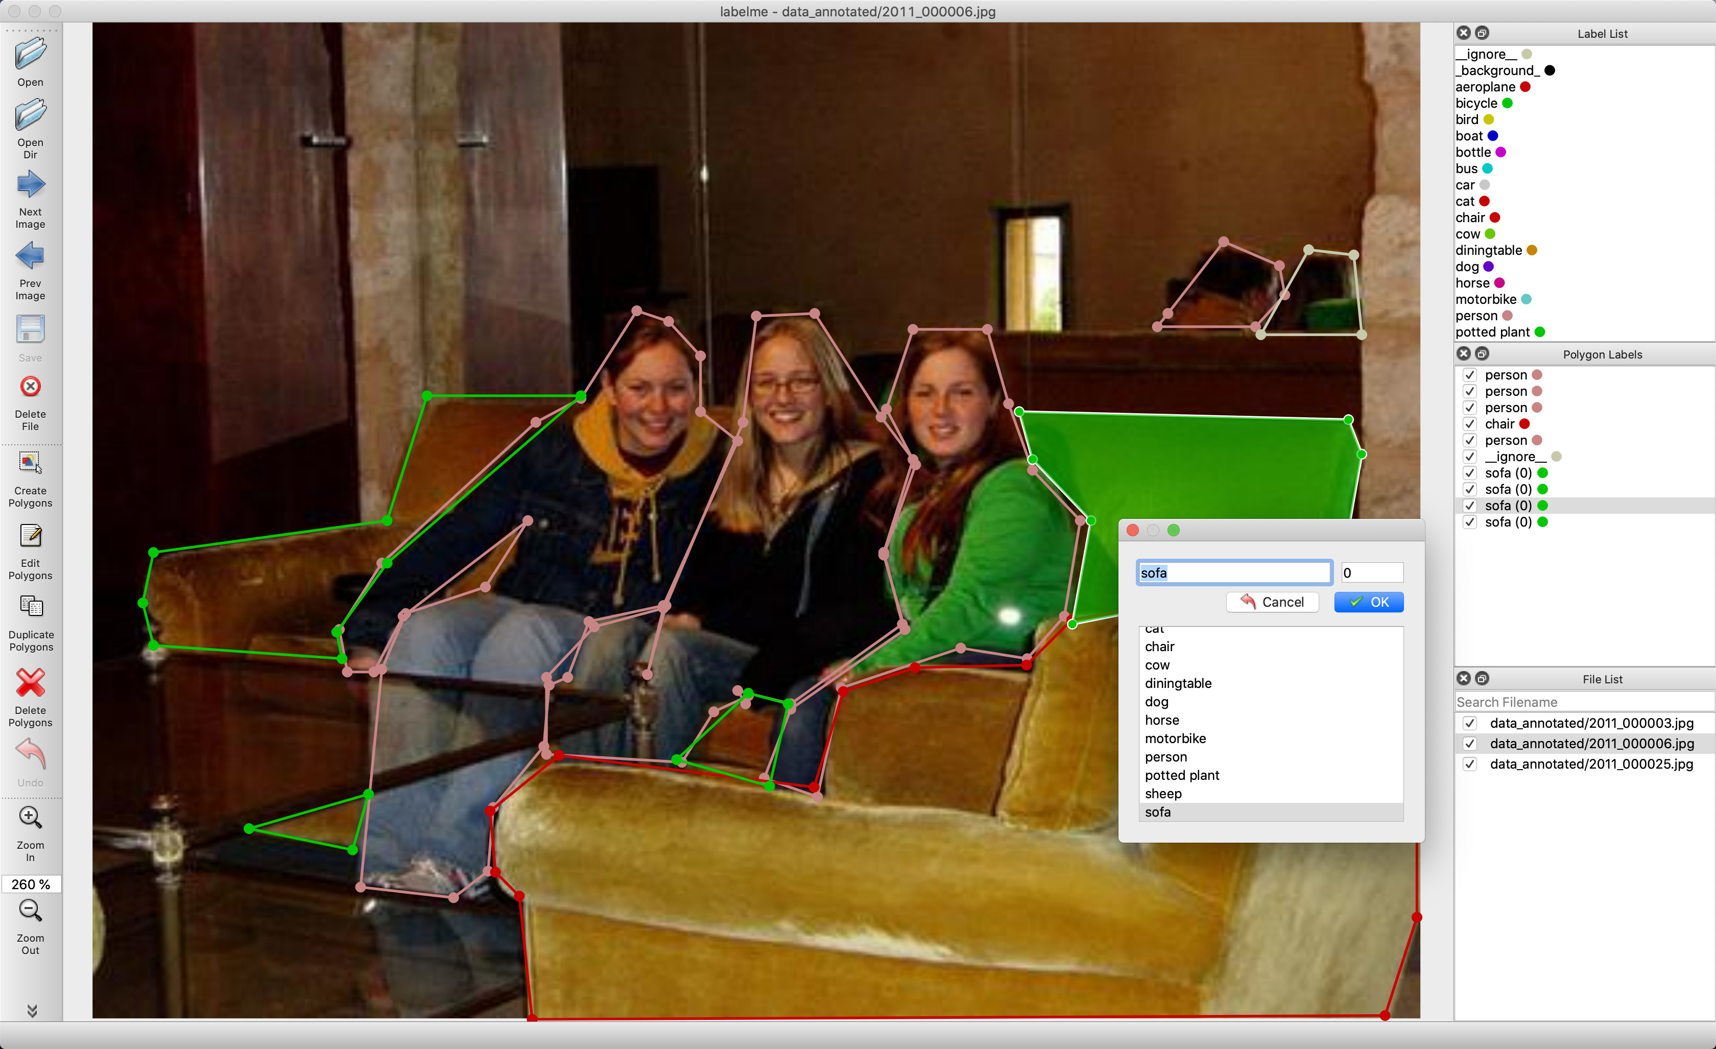
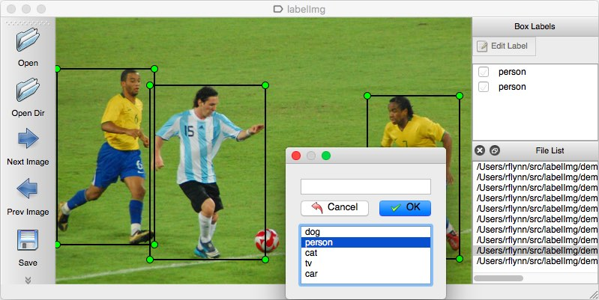
How to annotate data
Using specialized software!
Most are open source
We will explore two of the more popular ones today:
LabelImg (Object detection)
LabelMe (Segmentation)
Notes:
Images taken from respective GitHub pages

Slide 13
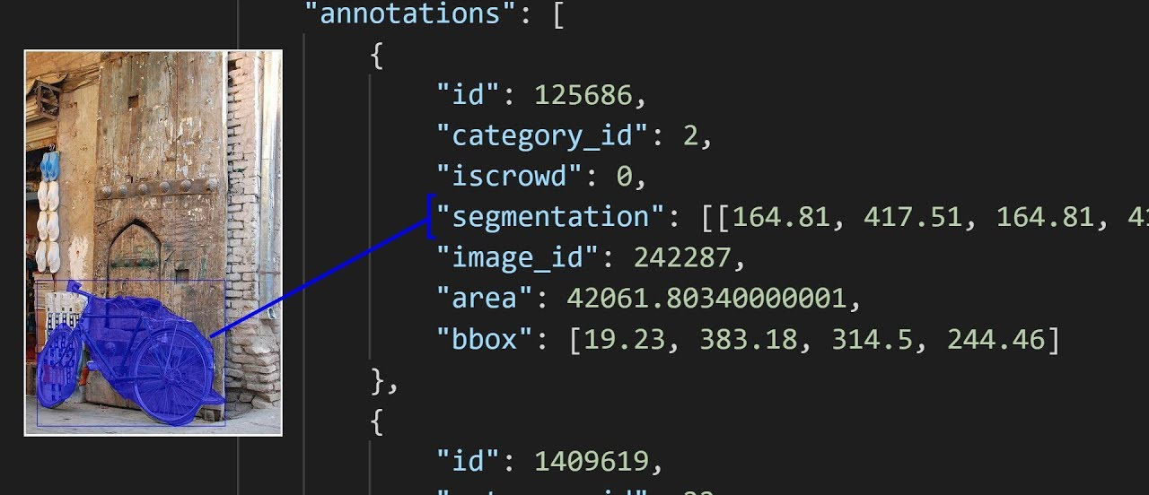
COCO Format
A single JSON file
Contains all annotations for all objects in all images
3 main sections:
Images
Annotations
Categories
"images": [ {"id": 242287, "width": 426, "height": 640, "file_name": "xxx.jpg"}, {"id": 245915, "width": 640, "height": 480, "file_name": "nnnn.jpg"} ]
"annotations": [ {"id": 125686, "category_id": 0, "iscrowd": 0, "segmentation": [[164.81, 417.51,......167.55, 410.64]], "image_id": 242287, "area": 42061.80340000001, "bbox": [19.23, 383.18, 314.5, 244.46]},
{"id": 1409619, "category_id": 0, "iscrowd": 0, "segmentation": [[376.81, 238.8,........382.74, 241.17]], "image_id": 245915, "area": 3556.2197000000015, "bbox": [399, 251, 155, 101]}]
"categories": [ {"id": 0,"name": "echo"}, {"id": 1,"name": "echo dot"} ]
Notes:
Source: https://www.immersivelimit.com/tutorials/create-coco-annotations-from-scratch

Slide 14
Other Dataset Formats
YOLO
VOC
Software-specific formats
LabelMe saves their own format
LabelImg saves in VOC or YOLO format

Slide 15
Let’s download some toy datasets and scripts
Wheat head dataset
Tomato dataset
Notes:
Paste links inside chat and add QR codes to screen once available
[16 mins]

Slide 16
Live Demo!
Notes:
Show how to annotate images using both software, and see the end results (XML files)
Then use the scripts to convert to COCO format, and then show the json file to see the format more clearly
[15 mins]

Slide 17
Mean Average Precision
Notes:
Adapted from: https://towardsdatascience.com/map-mean-average-precision-might-confuse-you-5956f1bfa9e2

Slide 18
Mean Average Precision (mAP)
Popular evaluation metric used for object detection and segmentation
Higher better
mAP is NOT average of precision values, but precision is still involved

Slide 19


Revision: Precision & Recall
TP = True Positives
Correctly predicted as positive
FP = False Positives
Wrongly predicted as positive
FN = False Negatives
Wrongly predicted as negative

Slide 20
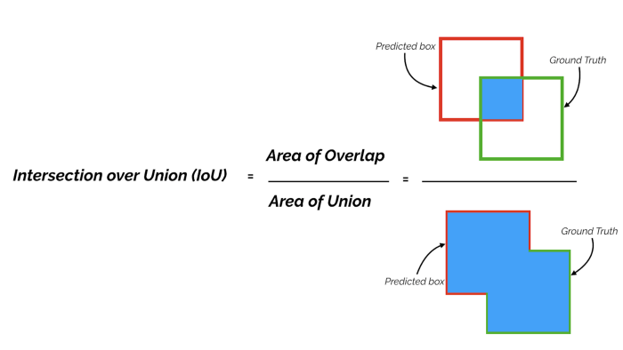
IoU (Intersection over Union)
For each bounding box, measure overlap between prediction and ground truth.
This is measured by IoU (intersection over union).

Slide 21
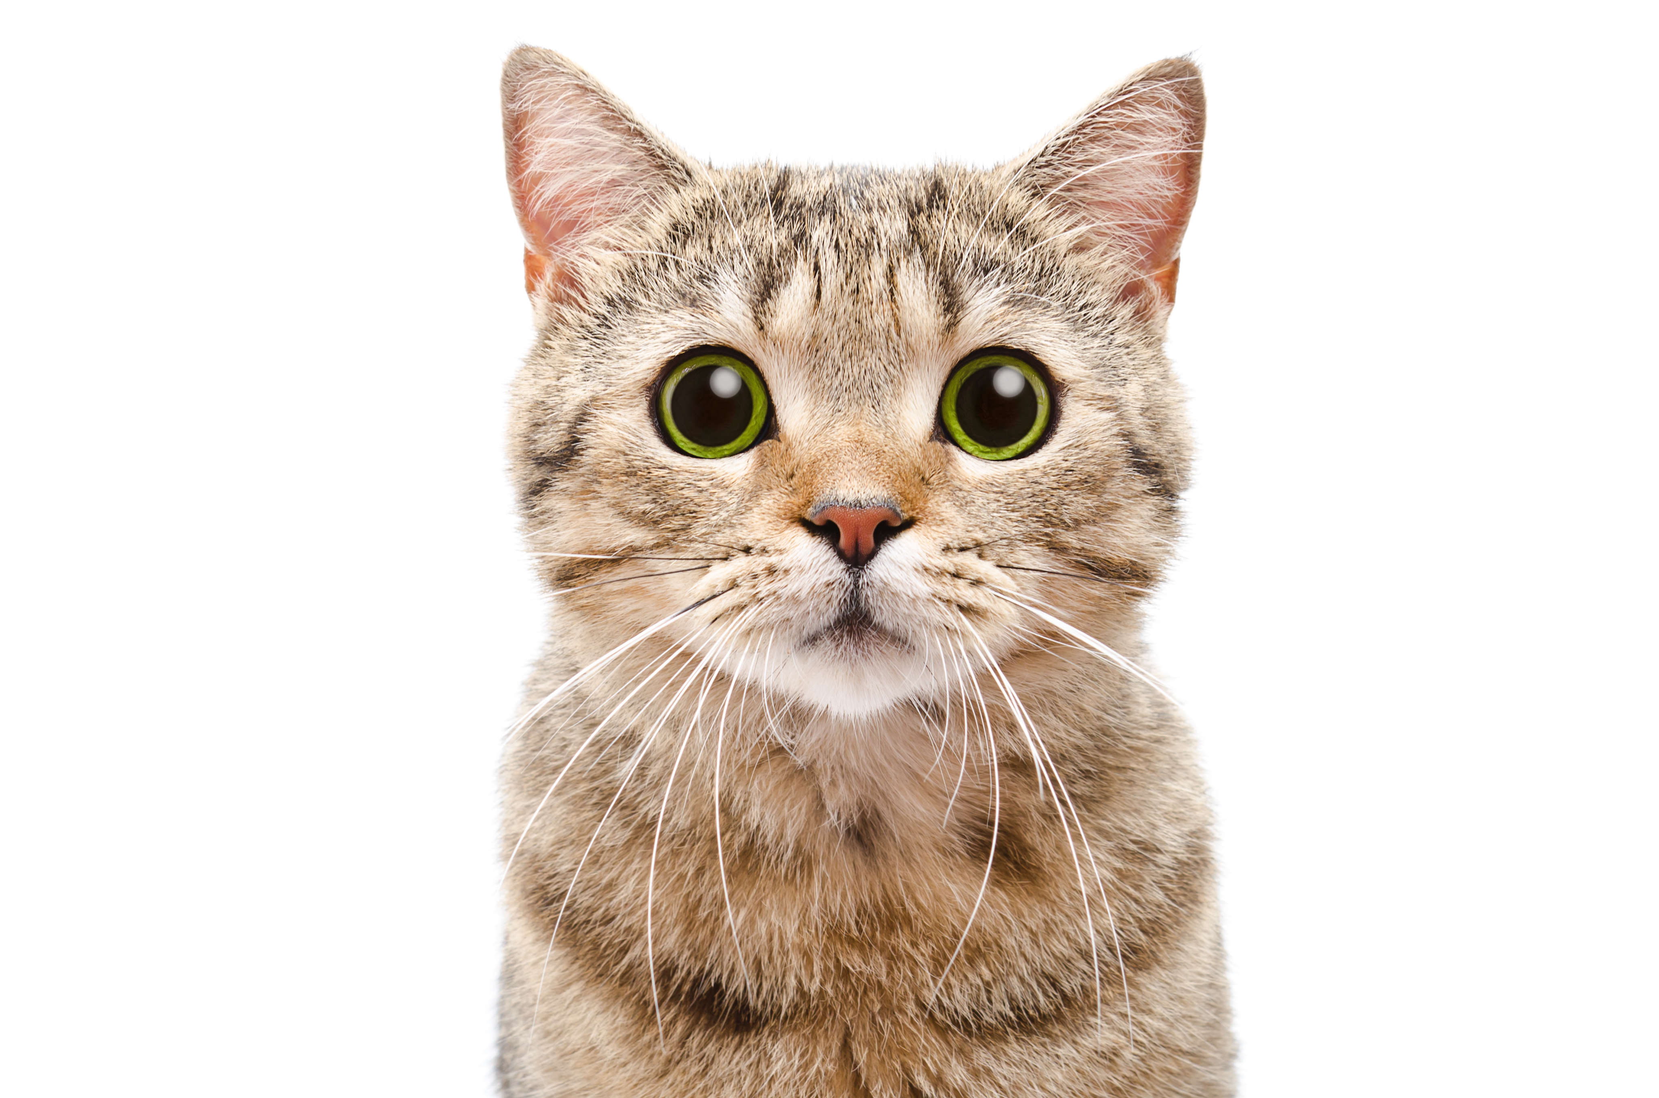
For an IoU threshold of 0.5
True Positive
cat
cat
IoU >= 0.5
Notes:
Source: https://timesofindia.indiatimes.com/photo/67586673.cms

Slide 22
For an IoU threshold of 0.5
False Positive
cat
cat
cat
cat
cat
IoU < 0.5
Duplicate Bbox
Notes:
Source: https://timesofindia.indiatimes.com/photo/67586673.cms

Slide 23
For an IoU threshold of 0.5
False Negative
cat
cat
dog
No detection
Wrong label
Notes:
Source: https://timesofindia.indiatimes.com/photo/67586673.cms

Slide 24
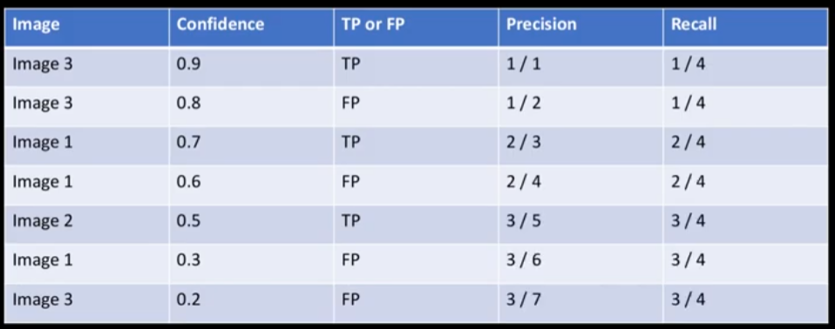
Calculating Mean Average Precision
Rank predictions by confidence
Calculate precision and recall for all the predicted bounding boxes for all images

Slide 25
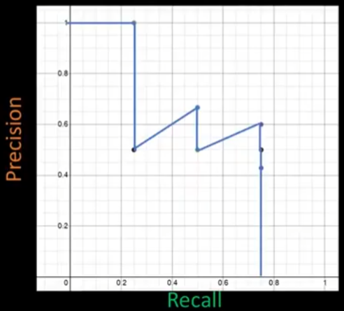
Calculating Mean Average Precision
Plot Precision-Recall graph
Calculate area under graph
Calculate for all classes (if more than 1 class)
Calculate for a given interval of IoU thresholds
0.5, 0.55, …, 0.9, 0.95
mAP = Average the values from Step 4

Slide 26
Getting started with Detectron2

Slide 27
What is Detectron2
“Detectron2 is Facebook AI Research's next generation library that provides state-of-the-art detection and segmentation algorithms”
Really high-level wrapper for PyTorch
Good balance between being suitable for deployment/production and development

Slide 28
Code Along!
Notes:
Insert QR code and tinyurl links

Slide 29
REST API Options
Flask/FastAPI
Customizable, can combine with other API calls
Must set up your own pipeline (loading, handling requests, inferring, response)
TorchServe
Official model serving library for PyTorch
Not so customizable but general pipeline is already provided for many kinds of models/tasks
Optimized to handle inference requests and batching

Slide 30
Data Dashboarding Libraries Options
StreamLit
Entirely in Python
Focuses more on rapid prototyping, easy to get a simple app up and running
Dash
Primarily designed to work with Plotly
More directed at a production / enterprise environment
Notes:
[25 min]

Slide 31
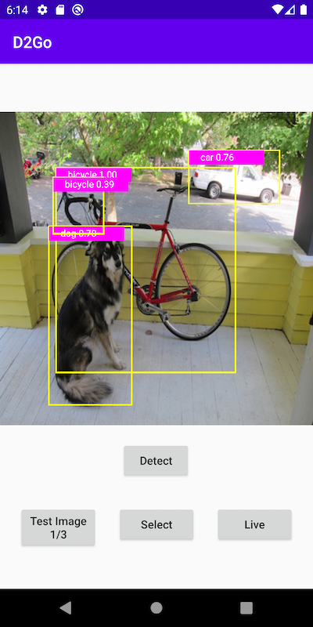
Android – D2Go
Detectron2 but for Android, smaller model zoo, but with support for mobile.
Template Android app can be found on GitHub

Slide 32
Any final questions?

